Slide 1
Lecture 4
Asynchronous Communication

Slide 2
This Week
The interactivity of an application that invokes slow methods at the remote end.
We will see how this issue can be addressed using asynchronous calls.
We will look at two main approaches of making asynchronous calls
- Remote Callback functions
- Asynchronous Messaging
Notes:
Asynchronous calls does not use a clock (not occurring at regular intervals); instead it uses packets with start bit and end bit.
When you execute something synchronously, you wait for it to finish before moving on to another task.
When you execute something asynchronously, you can move on to another task before it finishes.

Slide 3
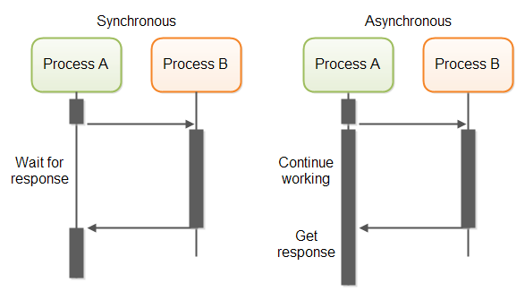

Slide 4
Blocking Calls and Distributed Computing
When a function is called, the caller typically must wait (block) until the called function completes & returns
In a distributed computing system, blocking for a remote call can easily be a waste of resources
  Especially if it is a call that could take a while
  i.e. Client waits while server performs a long job
  Not utilising resources properly/efficiently there!

Slide 5
Synchronous vs. Asynchronous
Synchronous invocation = blocking call
  Serial processing
  Control is passed to called function
  Caller cannot continue until called function returns
Asynchronous invocation = non-blocking call
  Parallel processing (or at least one way to implement it)
  Control is returned immediately to the caller
  Called function carries on in the background
  At some later time, caller retrieves function’s return value

Slide 6
Local asynchronous Calls
Reasons for using asynchronous calls
  Maintain GUI responsiveness
  Utilise resources of caller more efficiently
  (e.g. continue doing other work during a long-running call)
  Java AWT event handling

Slide 7
Distributed Asynchronous calls
In the client server model, the server is passive: the IPC is initiated by the client;
Some applications require the server to initiate communication upon certain events.
    monitoring
    games
    auctioning
    voting/polling
    chat-room
    message/bulletin board
    groupware
6 Maart 2006
ISS 2006

Slide 8
When to use Asynchronous Calls?
Every RPC call is potentially long-running
  Network/server failures are only detected after timeouts expire
  Making every RPC call asynchronous increases code complexity, just on the chance a network failure occurs
So use asynchronous calls only on functions that are expected to take a long time
  Heavy processing tasks, intensive disk I/O tasks, etc.
  For GUI clients, responsiveness is also a key issue

Slide 9
Remote asynchronous communication
Remote Callback functions
Messaging (e.g. JMS, Microsoft Messaging Queuing)
Both Java and .NET supports callback functions

Slide 10
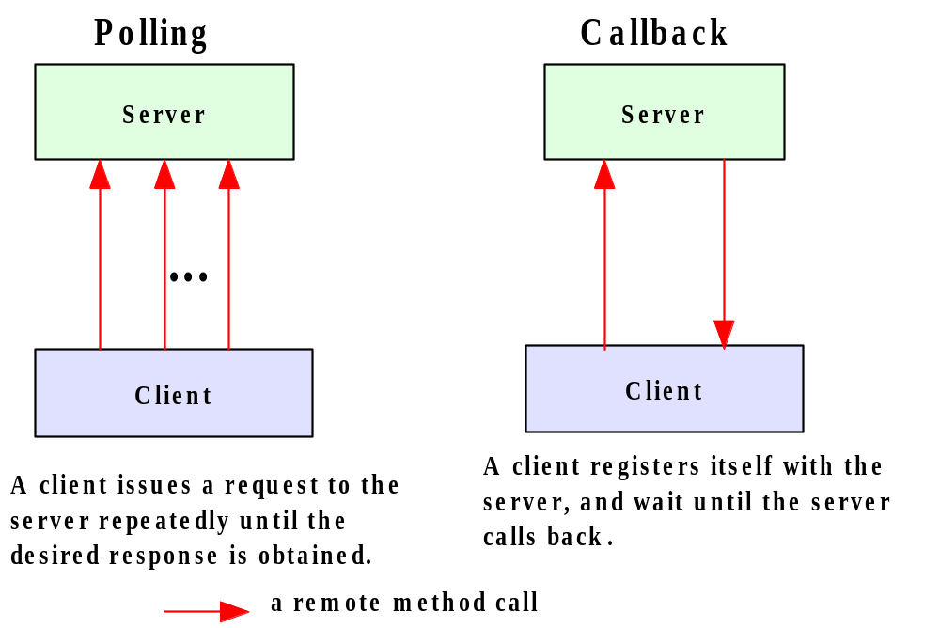
Polling vs. Callback
In the absence of callback, a client will have to poll a passive server repeatedly if it needs to be notified that an event has occurred at the server end.
6 Maart 2006
ISS 2006

Slide 11
Polling vs. Callback
Blocking is like making a call and waiting for the other party to respond (if the other party is busy with some other call)
Polling is like repeatedly making a telephone call and check whether the other party is available.
Callback is like making a call and leaving a message to other party to call back with certain information

Slide 12
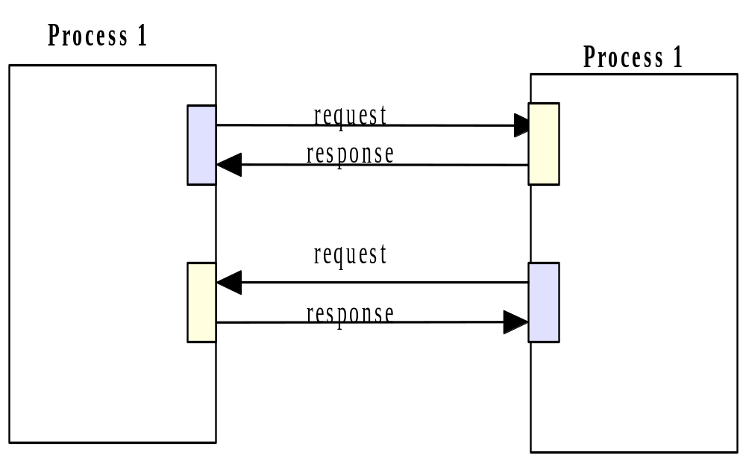
Two-way communications
Some applications require that both sides may initiate IPC.
Using sockets, duplex communication can be achieved by using two sockets on either side.
With connection-oriented sockets, each side acts as both a client and a server.

Slide 13
RMI Callbacks
6 Maart 2006
ISS 2006

Slide 14
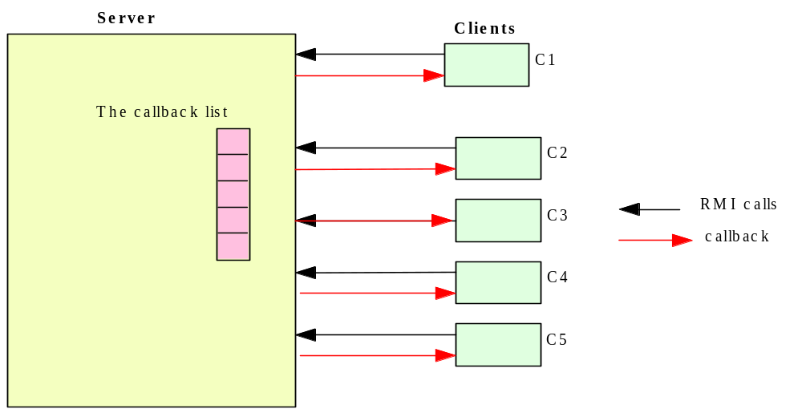
RMI Callbacks
A callback client registers itself with an RMI server.
The server makes a callback to each registered client upon the occurrence of a certain event.
6 Maart 2006
ISS 2006

Slide 15
Client callback
  To provide client callback, the client-side software
    supplies a remote interface,
    instantiate an object which implements the interface,
    passes a reference to the object to the server via a remote method call to the server.

Slide 16
Client callback
  The remote server:
    collects these client references in a data structure.
    when the awaited event occurs, the remote server invokes the callback method (defined in the client remote interface) to pass data to the client.
  Two sets of stub-skeletons are needed: one for the server remote interface, the other one for the client remote interface.
ISS 2006

Slide 17
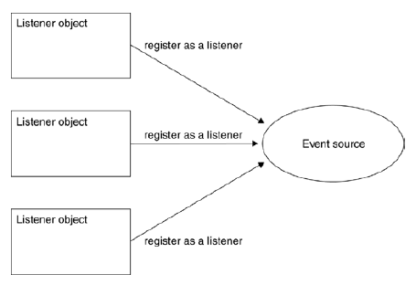
Multiple listeners
6 Maart 2006
ISS 2006

Slide 18
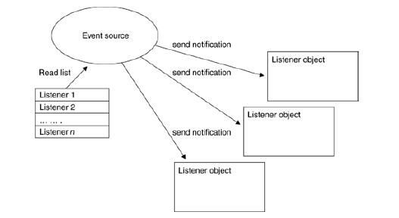
Callback notification to every registered listener
6 Maart 2006
ISS 2006

Slide 19
Callback notification to every registered listener
6 Maart 2006
ISS 2006

Slide 20
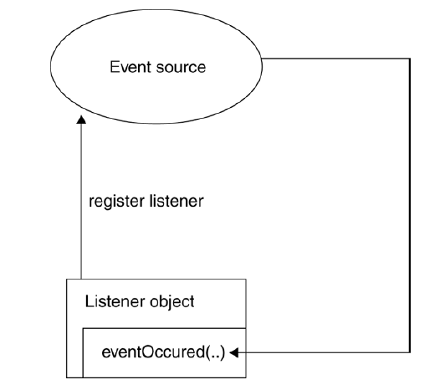
Callback implemented by invoking a method on a listening object
6 Maart 2006
ISS 2006

Slide 21
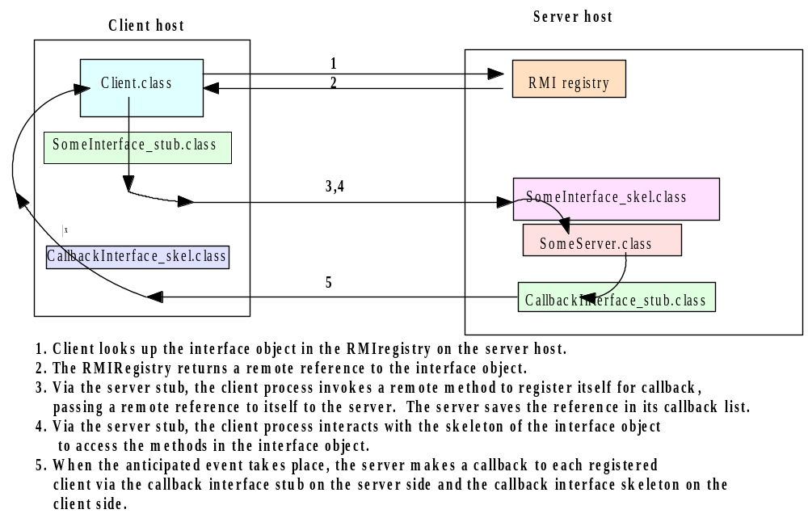
Callback Client-Server Interactions
6 Maart 2006
ISS 2006

Slide 22
RMI Callback Example
  Temperature monitoring system
  Server will sense the temperature of the environment
  The Server will notify the client listeners of the changes in temperature
  Polling is not efficient thus we can use callback as a means asynchronous notifications
  In addition to the normal RMI classes/interfaces there will be a client interface defined as well (so that the server can ‘call back’)
6 Maart 2006
ISS 2006

Slide 23
RMI Callback Example
  Server Interface (same as in blocking RMI)
interface TemperatureSensor extends java.rmi.Remote
{
public double getTemperature() throws
java.rmi.RemoteException;
public void addTemperatureListener
(TemperatureListener listener )
throws java.rmi.RemoteException;
public void removeTemperatureListener
(TemperatureListener listener )
throws java.rmi.RemoteException;
}
6 Maart 2006
ISS 2006

Slide 24
RMI Callback Example
  Listener Interface (Client side)
interface TemperatureListener extends java.rmi.Remote
{
public void temperatureChanged(double temperature)
throws java.rmi.RemoteException;
}
Defines the callback method
6 Maart 2006
ISS 2006

Slide 25
RMI Callback Example
  Server Implementation
public class TemperatureSensorServer extends UnicastRemoteObject implements TemperatureSensor, Runnable{
public void addTemperatureListener ( TemperatureListener
listener ) throws java.rmi.RemoteException{
list.add (listener);
}
public void run(){
for (;;) { {
if(checkTempChanged()){
// Notify registered listeners
notifyListeners();
}
}
}
6 Maart 2006
ISS 2006

Slide 26
RMI Callback Example
private void notifyListeners(){
for (Enumeration e = list.elements(); e.hasMoreElements(); ){
TemperatureListener listener = (TemperatureListener)
e.nextElement();
listener.temperatureChanged (temp);
list.remove( listener );
  }
}
public static void main(String args[]){
TemperatureSensorServer sensor = new TemperatureSensorServer();
String registration = "rmi://" + registry +"/TemperatureSensor";
Naming.rebind( registration, sensor );
Thread thread = new Thread (sensor);
thread.start();
}
}
6 Maart 2006
ISS 2006

Slide 27
RMI Callback Example
Client implementation
public class TemperatureMonitor extends UnicastRemoteObject
implements TemperatureListener{
public static void main(String args[]){
Remote remoteService = Naming.lookup ( registration );
TemperatureSensor sensor = (TemperatureSensor)remoteService;
double reading = sensor.getTemperature();
System.out.println ("Original temp : " + reading);
TemperatureMonitor monitor = new TemperatureMonitor();
sensor.addTemperatureListener(monitor);
}
public void temperatureChanged(double temperature)
throws java.rmi.RemoteException
{
System.out.println ("Temperature change event : " +
temperature);
}
6 Maart 2006
ISS 2006

Slide 28
Running the example
Compile the applications and generate stub/skeleton files for both
TemperatureSensorServer and TemperatureSensorMonitor.
Run the rmiregistry application.
Run the TemperatureSensorServer.
Run the TemperatureSensorMonitor.
6 Maart 2006
ISS 2006

Slide 29
Asynchronous Callback functions and thread safety
Callback functions use threads in the background
Worker thread does the remote call and then calls the callback function
Main thread is running at the same time
Have to handle thread safety issues manually

Slide 30
Asynchronous Messaging services

Slide 31
Java Message Service (JMS)
A specification that describes a common way for Java programs to create, send, receive and read distributed enterprise messages
loosely coupled communication
Asynchronous messaging
Reliable delivery
  A message is guaranteed to be delivered once and only once.
Outside the specification
  Security services
  Management services
Notes:
Asynchronous. A JMS provider can deliver messages to a client as they arrive; a client does not have to request messages in order to receive them.
Lower levels of reliability are available for applications that can afford to miss messages or to receive duplicate messages.
The JMS specification describes a set of programming interfaces that support distributed, enterprise messaging. An enterprise messaging systems enables independent distributed components or applications to interact through messages. These components, whether on the same system, the same network, or loosely connected through the Internet, use messaging to pass data and coordinate their respective functions.
exposing only the JMS APIs is to hide the details from the users that want a higher-level API and also to ensure portability among implementations.
As long as the vendor adheres to the JMS specification, a user shouldn't have to worry too much about how the implementation is constructed.
By itself, it provides no functionality: the API or interfaces are separate from the implementation This gives the benefit of describing in detail what the user view should be, while at the same time allowing vendors to implement the details however they want.
JMS is not an implementation of a message-oriented middleware.
security and management are not the concerns of the JMS spec

Slide 32
A JMS Application
JMS Clients
  Java programs that send/receive messages
Messages
Administered Objects
  preconfigured JMS objects created by an admin for the use of clients
  ConnectionFactory, Destination (queue or topic)
JMS Provider
  messaging system that implements JMS and administrative functionality
Notes:
A JMS Application is one or more JMS clients that exchange messages asynchronously

Slide 33
JMS Administration
Administrative
Tool
Bind
JNDI Namespace
Lookup
JMS Provider
JMS Client
Logical
Connection
Notes:
JNDI:java naming and directory service
administrative tool allows you to bind cf,dest to jndi. Clients lookup the admin objects in the jndi and then establish a logical connection to the same objects through provider
2 types of administrative objects: connection factory, destination
administrated objects are placed in a JNDI by admin.
a JMS client notes in its documentation the JMS admin objects it requires and how the JNDI names of these objects should be provided to it.
Connection factories are created by the server administrator and bound into the Java Naming and Directory Interface (JNDI) tree.
A JMS client uses JNDI to look up the ConnectionFactory and then uses the ConnectionFactory to establish a JMS connection.

Slide 34
JMS Messaging Domains
Point-to-Point (PTP)
  built around the concept of message queues
  each message has only one consumer
Publish-Subscribe systems
  uses a “topic” to send and receive messages
  each message has multiple consumers
Notes:
A JMS Application is one or more JMS clients that exchange messages asynchronously.
JMS deals with two kinds of message domains. -
Point-to-Point (PTP) are built around the concept of message queues.
Publish-Subscribe systems use a “topic” to send and receive messages.
Supports messages containing Java objects and XML pages.

Slide 35
Point-to-Point Messaging
Msg
Msg
consumes
Client1
Client2
Queue
sends
acknowledges
Notes:
1 consumer
a sender and a receiver have no timing dependencies. the receiver can fetch the mesg whether or not it was running when client sent the msg
receiver acknowledges

Slide 36
Publish/Subscribe Messaging
subscribes
Topic
Client2
Msg
Client1
delivers
publishes
subscribes
Client3
delivers
Notes:
multiple consumers
publishers and subscribers have timing dependency. a client can consume only msgs published after its subscription and must continue to be active to consume msgs
( exception durable subscription)

Slide 37
Message Consumptions
Synchronously
  A subscriber or a receiver explicitly fetches the message from the destination by calling the receive method.
  The receive method can block until a message arrives or can time out if a message does not arrive within a specified time limit.
Asynchronously
  A client can register a message listener with a consumer.
  Whenever a message arrives at the destination, the JMS provider delivers the message by calling the listener's onMessage() method.
Notes:
A message listener is similar to an event listener

Slide 38
JMS API Programming Model
Connection
Factory
creates
Connection
Message
Producer
Message
Consumer
creates
Session
creates
receives
from
sends to
creates
Destination
Msg
Destination
Notes:
JMS Interfaces:
connectionfactory: administrative object used by client to create a connection
connection: an active connection for JMS provider
destination: administrative object that encapsulates the identity of a message destination
session: a single-threaded context for sending/receiving message
messageproducer: an object created by a session that is used for sending msg to a dest
messageconsumer: similar

Slide 39
JMS Client Example
Setting up a connection and creating a session
InitialContext jndiContext=new InitialContext();
//look up for the connection factory
ConnectionFactory cf=jndiContext.lookup(connectionfactoryname);
//create a connection
Connection connection=cf.createConnection();
//create a session
Session session=connection.createSession(false,Session.AUTO_ACKNOWLEDGE);
//create a destination object
Destination dest1=(Queue) jndiContext.lookup(“/jms/myQueue”); //for PointToPoint
Destination dest2=(Topic)jndiContext.lookup(“/jms/myTopic”); //for publish-subscribe
Notes:
transacted session
connection.createSession(true,0);
AUTO_ACK: when client succesfully returned froma call to receive or when messagelistener returned successfully
Client_ACK: a client acks a mesg by calling the message’s acknowledge() method ( consume 10 ack 5th, you acked for all 10)
DUPS_ACK:dups are permitted, lazy ack (??)

Slide 40
Producer Sample
Setup connection and create a session
Creating producer
MessageProducer producer=session.createProducer(dest1);
Send a message
Message m=session.createTextMessage();
m.setText(“just another message”);
producer.send(m);
Closing the connection
connection.close();
Notes:
transacted session
connection.createSession(true,0);
AUTO_ACK: when client succesfully returned froma call to receive or when messagelistener returned successfully
Client_ACK: a client acks a mesg by calling the message’s acknowledge() method ( consume 10 ack 5th, you acked for all 10)
DUPS_ACK:dups are permitted, lazy ack (??)

Slide 41
Consumer Sample (Synchronous)
Setup connection and create a session
Creating consumer
MessageConsumer consumer=session.createConsumer(dest1);
Start receiving messages
connection.start();
Message m=consumer.receive();

Slide 42
Consumer Sample (Asynchronous)
Setup the connection, create a session
Create consumer
Registering the listener
  MessageListener listener=new myListener();
  consumer.setMessageListener(listener);
myListener should have onMessage()
  public void onMessage(Message msg){
  //read the massage and do computation
  }
Notes:
register the listener

Slide 43
Listener Example
public void onMessage(Message message) {
TextMessage msg = null;
try {
if (message instanceof TextMessage) {
msg = (TextMessage) message;
System.out.println("Reading message: " + msg.getText());
} else {
System.out.println("Message of wrong type: " +
message.getClass().getName());
}
} catch (JMSException e) {
System.out.println("JMSException in onMessage(): " + e.toString());
} catch (Throwable t) {
System.out.println("Exception in onMessage():" + t.getMessage());
}
}

Slide 44
JMS Messages
Message Header
  used for identifying and routing messages
  contains vendor-specified values, but could also contain application-specific data
  typically name/value pairs
Message Properties (optional)
Message Body(optional)
  contains the data
  five different message body types in the JMS specification

Slide 45
JMS Message Types
Message Type | Contains | Some Methods
TextMessage | String | getText,setText
MapMessage | set of name/value pairs | setString,setDouble,setLong,getDouble,getString
BytesMessage | stream of uninterpreted bytes | writeBytes,readBytes
StreamMessage | stream of primitive values | writeString,writeDouble,writeLong,readString
ObjectMessage | serialize object | setObject,getObject
Notes:
TextMessage m=session.createTextMessage();

Slide 46
More JMS Features
Durable subscription
  by default a subscriber gets only messages published on a topic while a subscriber is alive
  durable subscription retains messages until a they are received by a subscriber or expire
Request/Reply
  by creating temporary queues and topics
    Session.createTemporaryQueue()
  producer=session.createProducer(msg.getJMSReplyTo());
  reply= session.createTextMessage(“reply”);
  reply.setJMSCorrelationID(msg.getJMSMessageID);
  producer.send(reply);
Notes:
producer=session.createProducer(msg.getJMSReplyTo());
reply= session.createTextMessage(“reply”);
reply.setJMSCorrelationID(msg.getJMSMessageID);
producer.send(reply);

Slide 47
More JMS Features
Transacted sessions
  session=connection.createSession(true,0)
  combination of queue and topic operation in one transaction is allowed
  void onMessage(Message m) {
  try { Message m2=processOrder(m);
  publisher.publish(m2); session.commit();
  } catch(Exception e) { session.rollback(); }

Slide 48
More JMS Features
Persistent/nonpersistent delivery
  producer.setDeliveryMethod(DeliveryMode.NON_PERSISTENT);
  producer.send(mesg, DeliveryMode.NON_PERSISTENT ,3,1000);
Message selectors
  SQL-like syntax for accessing header:
  subscriber = session.createSubscriber(topic, “priority > 6 AND type = ‘alert’ ”);
  Point to point: selector determines single recipient
  Pub-sub: acts as filter
Notes:
send(msg,persistent, 3,100)
3: priority( default 4)
100: timeout (0 : no timeout)

Slide 49
JMS Providers
SunONE Message Queue (SUN)
MQ JMS (IBM)
WebLogic JMS (BEA)
JMSCourier (Codemesh)
Apache ActiveMQ

Slide 50
JMS API in a J2EE Application
Since the J2EE1.3 , the JMS API has been an integral part of the platform
J2EE components can use the JMS API to send messages that can be consumed asynchronously by a specialized Enterprise Java Bean
  message-driven bean
Notes:
Since the 1.3 release of the J2EE platform ("the J2EE 1.3 platform"), the JMS API has been an integral part of the platform, and application developers can use messaging with components using J2EE APIs ("J2EE components").
J2EE Application server provides EJB, freeing applications from details of threading, transactions, scalability, fault-tolerance
J2EE components (Web components or Enterprise JavaBeans (EJB) components) can use the JMS API to send messages that can be consumed asynchronously by a specialized EJB, called a message-driven bean (MDB).
EJB is a server-side component that encapsulates the business logic of an application

Slide 51
Microsoft Messaging Queue
.NET Equivalent of JMS
https://msdn.microsoft.com/en-us/library/ms731089.aspx

Slide 52
Summary
Asynchronous Communication helps to make non blocking calls among distributed components
It maximizes the performance and response time of distributed Systems
Callback functions and Messaging Services are two common ways of implementing asynchronous communication
Some calls may have to be synchronous (blocking) if further processing cannot be done without the information in server response

